Slide 1
SIMPLE CLUSTERS BASED ON WIN RATES

Slide 2
SECTIONS
Summary
Method
Clusters verbally described
Clusters visually described
Table of aggregated values by cluster
Hierachical clustering on principal components
Clusters displayed on scatter plots
Variable relevance per cluster
Clusters over time
Cluster populations by college and major institutions

Slide 3
1. SUMMARY
This shows principal investigators sorted into eight clusters using only two criteria: the win rates by count of proposal and sum of funds requested.

Slide 4
2. METHOD
First, principal investigators (PI’s) with three or fewer proposals are filtered out. 1,265 principal investigators (43%) are removed and 1,672 principal investigators (57%) are kept.
Second, two variables are calculated per principal investigator:
Rate of proposals won (count rate)
Rate of funds requested won (sum rate)
Third, the rates are centered and scaled.
Fourth, principle components are extracted.
Fifth, hierarchical clustering using Euclidean distance and Ward’s method is used to produce eight clusters.
The clusters are named, described verbally and visually, and the cluster populations by colleges and major institutions are shown.

Slide 5
3. CLUSTERS VERBALLY DESCRIBED
CLUSTER 1: ROCK BOTTOM Principal investigators in Cluster 1 have less than ~20% win rates by both count and sum.
It has a population of 211 PIs (12.6%) and accounts for only 2.1% of total requested funds won.
CLUSTER 2: DOMINANT Principal investigators in Cluster 2 have less than ~40% win rates by both count and sum.
It has the largest share of the population and proposals submitted, as well as a large share of funds awarded.
It has a population of 370 PIs (22.1%) and accounts for 16.6% of total requested funds won.
CLUSTER 3: BIG WHIFF Principal investigators in Cluster 3 have less than ~30% win rates by sum and less than ~70% win rate by count.
They have a respectable win rate by count but lose the larger proposals.
Cluster 3 has a population of 190 PIs (11.4%) and accounts for 5.5% of total requested funds won.
CLUSTER 4: MONEY Principal investigators in Cluster 4 have less than ~60% win rates by sum and less than ~50% win rates by count.
It has the largest share of funds requested won.
Cluster 4 has a population of 245 PIs (14.7%) and accounts for 25.5% of total requested funds won.
CLUSTER 5: MISSING THE BIG WINS Principal investigators in Cluster 5 have less than ~50% win rates by sum and greater than ~50% win rates by count.
They have an excellent win rate by count but like Cluster 3, they lose the larger proposals.
Cluster 5 has a population of 151 PIs (9%) and accounts for a large majority (9.9%) of total requested funds won.
CLUSTER 6: BRONZE MEDAL
Principal investigators in Cluster 6 have greater than ~40% win rates by sum and less than ~65% win rates by count.
Their win rates by sum are in third place behind Clusters 7 and 8. And compared to Clusters 3 and 5, they win the large proposals.
Cluster 6 has a population of 156 PIs (9.3%) and accounts for a large majority (17.1%) of total requested funds won.
CLUSTER 7: SILVER MEDAL Principal investigators in Cluster 7 have greater than ~50% win rates by sum and greater than ~60% win rates by count. They have the second-highest win rates.
Cluster 7 has a population of 165 PIs (9.9%) and accounts for a large majority (14.1%) of total requested funds won.
CLUSTER 8: GOLD MEDAL Principal investigators in Cluster 8 have greater than ~80% win rates by sum and greater than ~65% win rates by count. They have the highest win rates.
Cluster 8 has a population of 184 PIs (11%) and accounts for a large majority (9.3%) of total requested funds won.

Slide 6
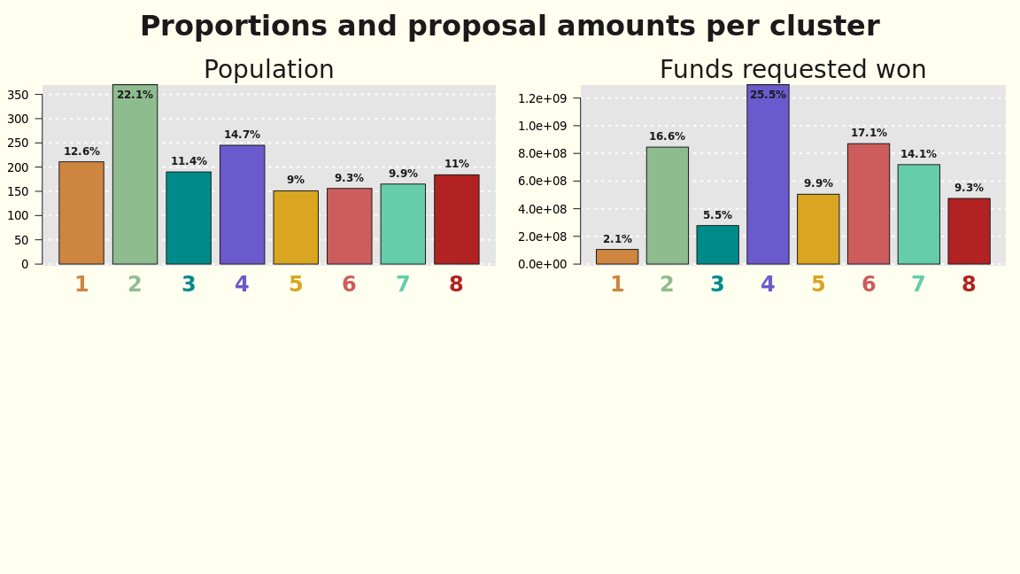
4. CLUSTERS VISUALLY DESCRIBED

Slide 7
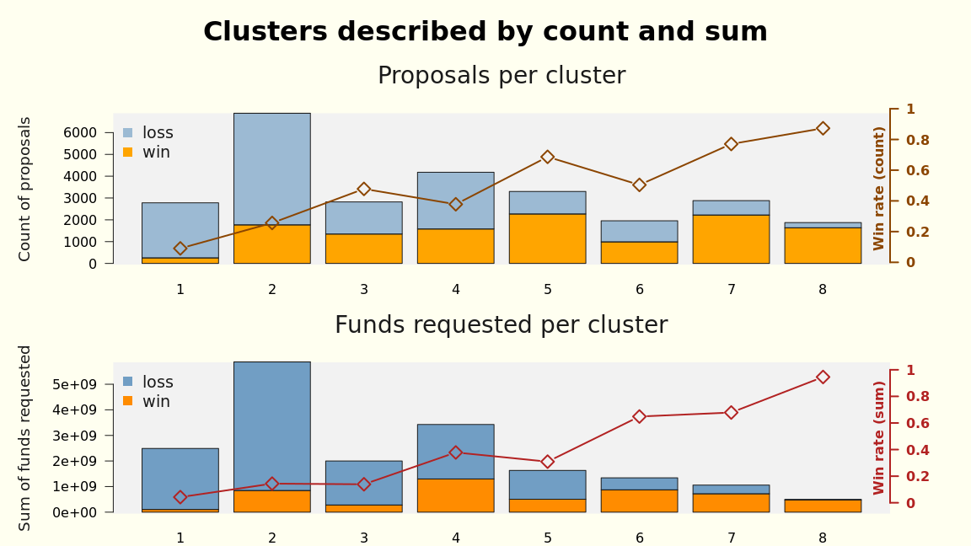
4. CLUSTERS DESCRIBED BY COUNT AND SUM

Slide 8
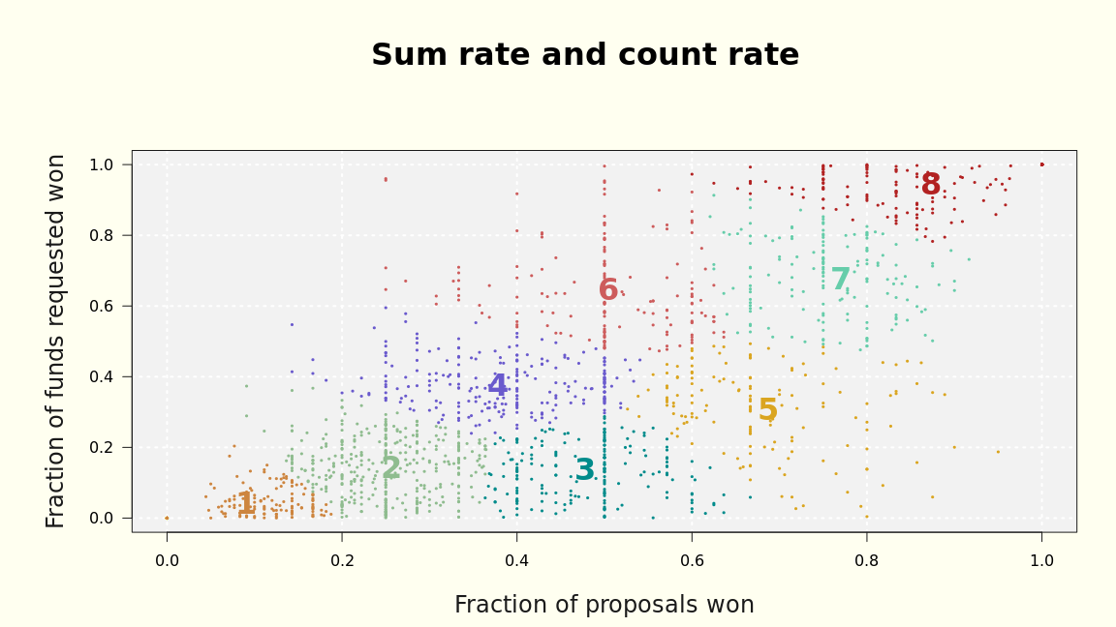
RATE SCATTER PLOT

